Slide 1

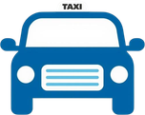
Information
Security
Taxi Trip Time
Prediction
Lam Sau Cheung
24030401D
SUPERVISOR
Prof YE Qingqing

Slide 2
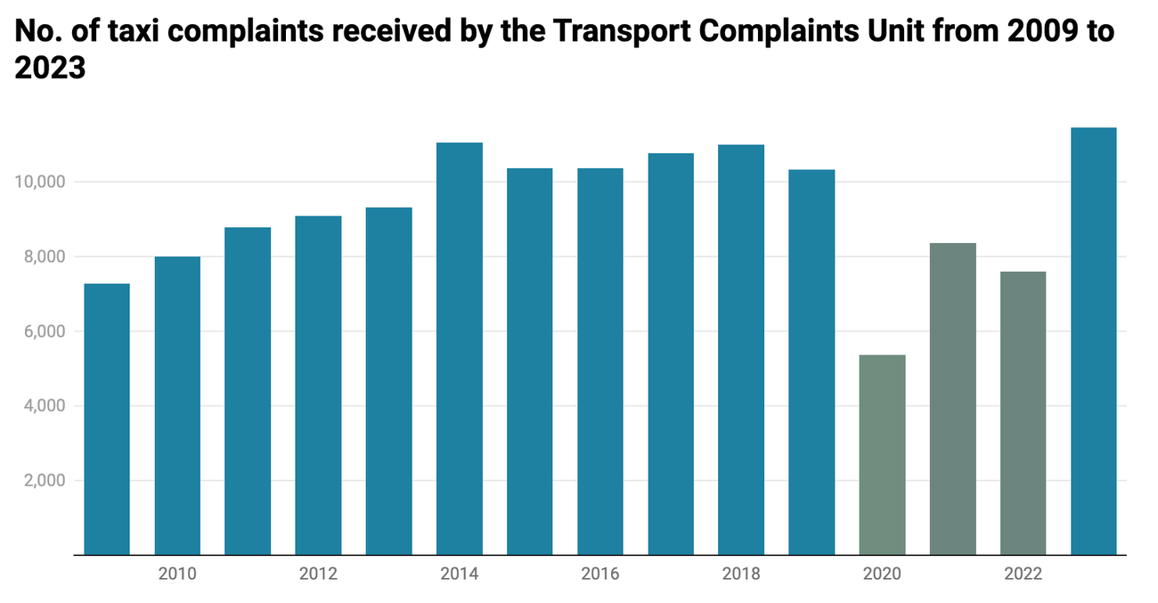
Background & Problem Statement
02
Complaint Reasons:
  Unpredictable trip times
  Failure to take the most direct route
  Driving behaviour(refusing hire)
More than 40% of all those received when considering figures per million passenger journeys
Figure 1. Number of taxi complaints received by the Transport Complaints Unit from 2009 to 2023[1].

Slide 3
02
Key Statistics on Taxi Issues
01
02
03
04
TOTAL COMPLAINTS
YEAR-ON-YEAR INCREASE
OVERCHARGING COMPLAINTS
FARE INCIDENTS
1,006 complaints filed against taxi services in 2023
75% increase in complaints compared to previous year
120% increase in overcharging-related complaints
300+ fare manipulation and refusal events recorded
The Transport Department[2]

Slide 4
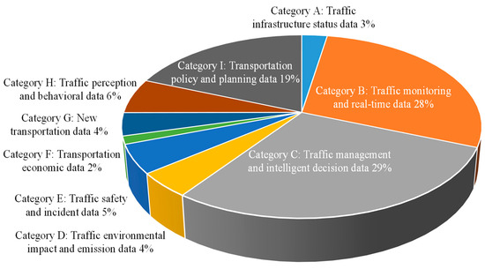
Background & Problem Statement
02
Decision Making
Traffic management and intelligent decision data : 29%
Traffic monitoring and real-time data:28%
Transportation policy and planning data:19%
Informational Foundation
Transportation planning
safety management
Economic analysis
Figure 2. Percentage distribution of the literature numbers of various types of urban transportation data[3].

Slide 5

03
Project Objectives
MAIN GOALS OF THE TAXI TRIP TIME PREDICTION SYSTEM
Calculate optimal route, direction, and estimated trip time from origin to destination.
Collect and process data via GPS coordinates, or place names input.
Provide multiple predicted route options for user comparison and selection.
Train and validate machine learning models for accurate trip time prediction.

Slide 6
04
Methodology – Data & Algorithms
Porto Taxi GPS Data
Dijkstra Algorithm
01
03
1.7M+ trajectories from Kaggle with precise coordinate timestamps.
Computes shortest path on OpenStreetMap road network graph.
Haversine Formula
Feature Engineering
02
04
Calculates straight-line distance and bearing between GPS coordinates.
Extracts hour, day, month, year to capture temporal traffic patterns.

Slide 7
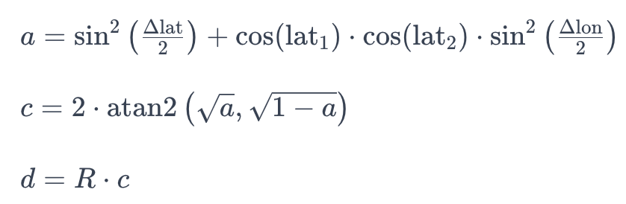
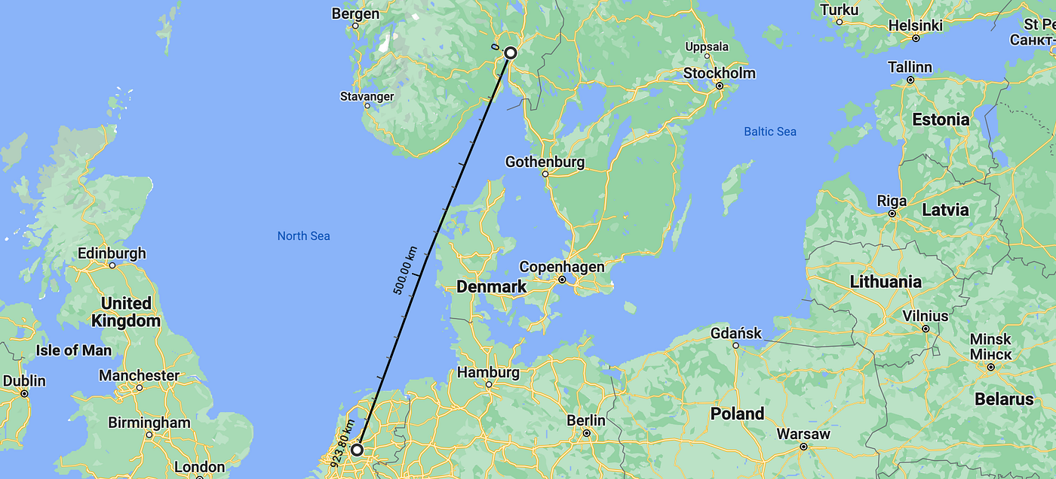
05
Haversine Formula
  Initial the original point and destination
  Obtain their coordinates
  Calculate the distance between the latitudes and longitudes
  Covert the latitudes to radians by power of math.pi/180
  Apply the formula a
  Apply the formula c
  Notes : d is distance, R is Earth radius
Dijkstra Algorithm
03
Computes shortest path on OpenStreetMap road network graph.

Slide 8
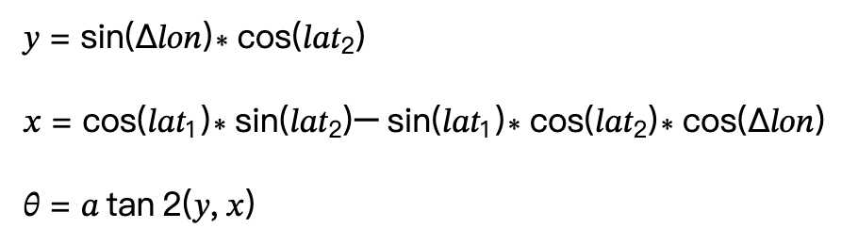
05
Initial Bearing (Haversine Formula)
  Initial the original point and destination
  Obtain their coordinates
  Calculate the distance between the latitudes and longitudes
  Covert the latitudes to radians by power of math.pi/180
  Apply the formula y
  Apply the formula x
  Apply the bearing formula θ and get the initial bearing B
  Convert the bearing B to readable direction by (B+22.5)//45
Dijkstra Algorithm
03
Computes shortest path on OpenStreetMap road network graph.
Bearing | 0 to 22.5 | 22.5 <B< 67.5 | 67.5<B<112.5 | 112.5<B<157.5 | 157.5<B<202.5 | 202.5<B<247.5 | 247.5<B<292.5 | 292.5<B<337.5
Direction | North | Northeast | East | Southeast | South | Southwest | West | Northwest

Slide 9
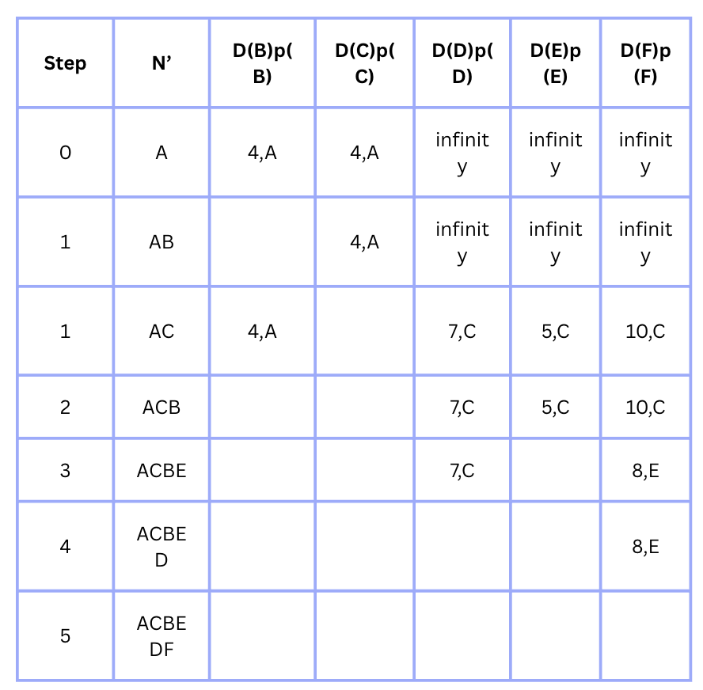
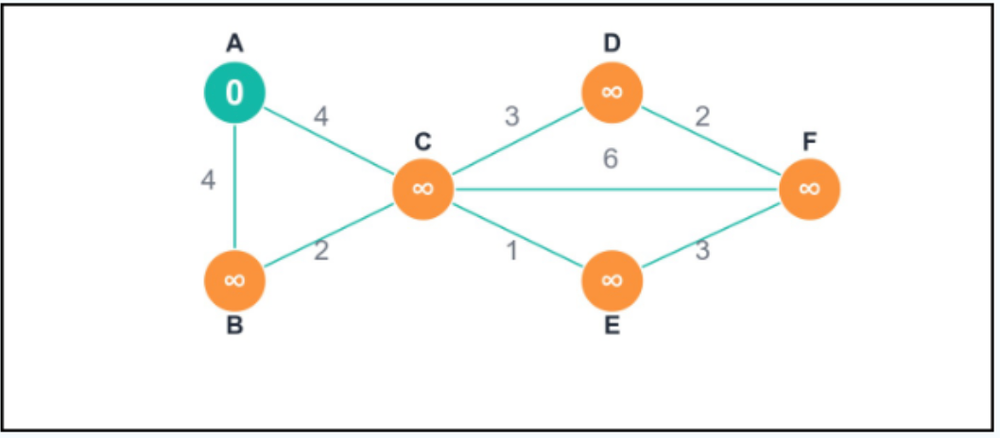
05
Dijkstra Algorithm
  Initial the starting node A and all other nodes
  Calculate all possible paths from A to other nodes
  Find the shortest path to other nodes
  Confirm destination node like F
  Select the possible shortest path from A to F
  Once all nodes have been calculated, the algorithm terminates. The final shortest distance from A to F is 8.
Dijkstra Algorithm
03
Computes shortest path on OpenStreetMap road network graph.

Slide 10





K-NEAREST NEIGHBORS (KNN)
DECISION TREE REGRESSION
RANDOM FOREST
LINEAR REGRESSION
XGBOOST
OVERALL TRAINING AND TESTING DATA (70% FOR TRAINING AND 30% FOR TESTING)
  Input features: Length, Hour, Day, Month, Year
  Input target: Trip Time
  StandardScaler: normalization input data

Slide 11

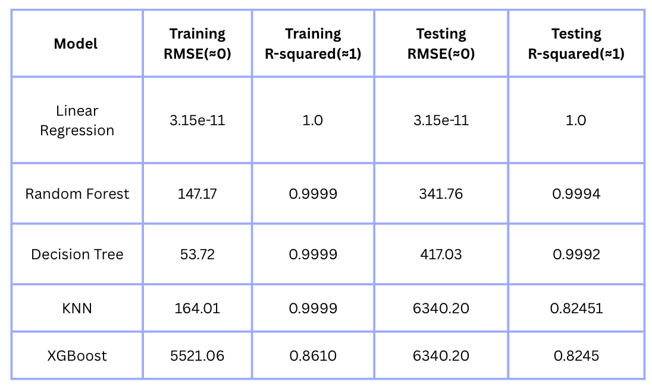
Model Performance Comparison
06
OVERALL TRAINING AND TESTING RESULTS (70% FOR TRAINING AND 30% FOR TESTING)

Slide 12

07
System Functions Overview
SUMMARY OF MAIN SYSTEM FEATURES
Trip time estimation combining historical GPS data and ML model predictions
Distance and direction calculation using Dijkstra algorithms with Haversine formula for reference.
Data visualization: heatmaps & marker maps for trip distribution analysis.
Interactive Flask web interface with Folium maps supporting coordinates or place names.

Slide 13
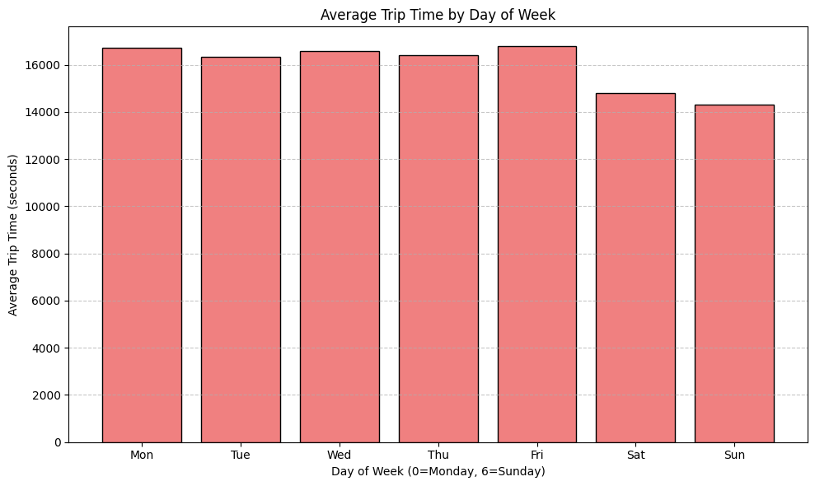


08
Factor Analysis
~18,000s
PEAK DAY TRIP TIME (WEEKDAYS)
WEEKLY PATTERNS
WeekDays(Monday to Firday): around 16,000s to 18,000 seconds
WeekEnd(Saturday to Sunday): around 14,000s to 15,000 seconds
Insights: System should consider the working day and remain user may facing long trip time in weekdays
Weekday trips are longer than weekend trips on average.

Slide 14
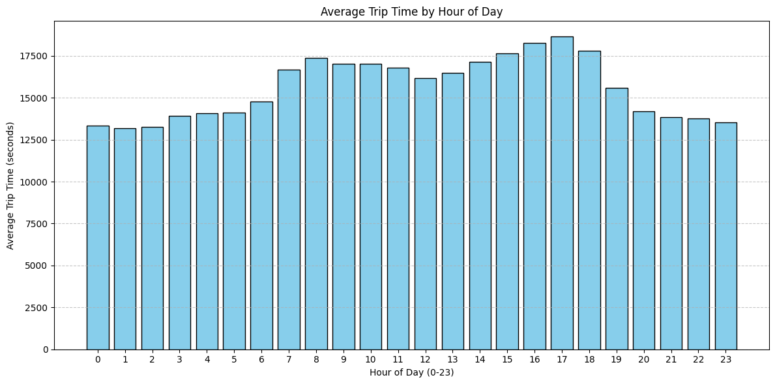
09
Factor Analysis
~18,640s
PEAK HOUR TRIP TIME (17:00)
RUSH HOUR IMPACT
Peak trip times occur during 7-9am and 4-7pm rush hours.
Hour 17(the busiest hours): around 18640.21 seconds
Hour 1(the least busiest hour): around 13167.53 seconds
Compared to the overall average: 3034.83 seconds
Insights: System should remain user may facing the longer travel time and select to travel during off-peak hours.

Slide 15
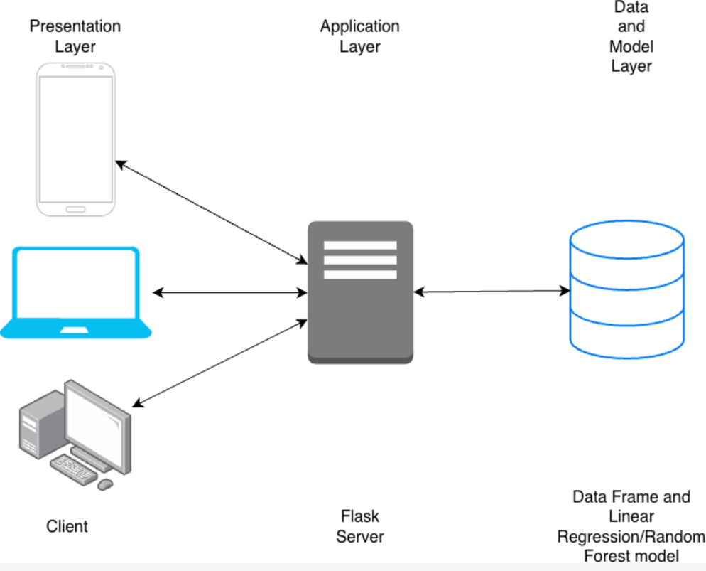
10
System Architecture
THREE-LAYER SYSTEM DESIGN OVERVIEW
02
DATA & MODEL
LAYER
PRESENTATION
LAYER
Pre-trained ML models + OpenStreetMap road network graph.
Tailwind CSS + JavaScript for responsive UI and async API calls.
APPLICATION
LAYER
01
Flask RESTful API managing routing and model prediction.
03

Slide 16
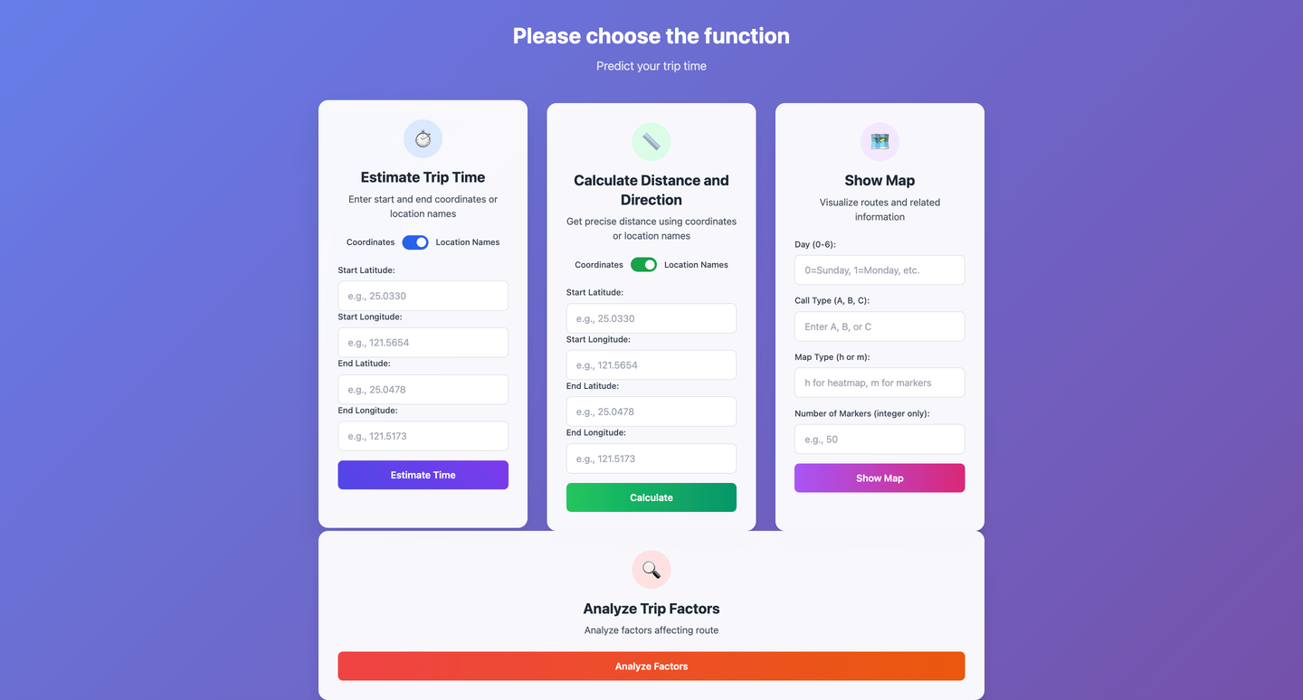
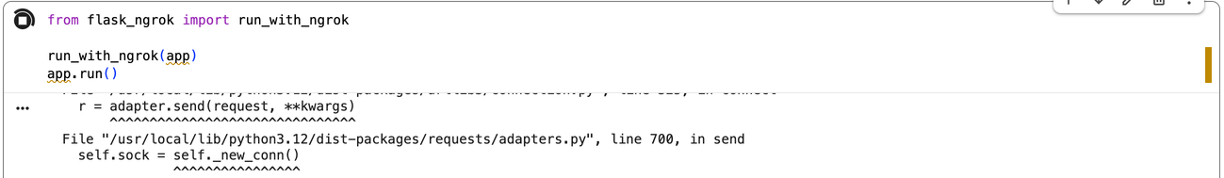
11
System Implementation Details
Python Environment
01
Google Colaboratory for cloud-based development and model training.
TECHNICAL STACK POWERING THE PREDICTION SYSTEM
02
Backend Stack
Flask, Pandas, NumPy, OSMnx, NetworkX for API and geospatial processing.
ML Integration
03
Serialized models via joblib enabling real-time inference capabilities.
04
Frontend Design
Tailwind CSS responsive UI with JavaScript async API calls.

Slide 17

12
Final Results
MAIN SYSTEM OUTCOMES AND UI FEATURES
User-friendly interface that supporting both GPS coordinates and place names.
Displays predicted trip time, distance, direction, and interactive map.
Supports both driving and public transport route options.
Heatmaps and marker maps reveal trip distribution hotspots.

Slide 18
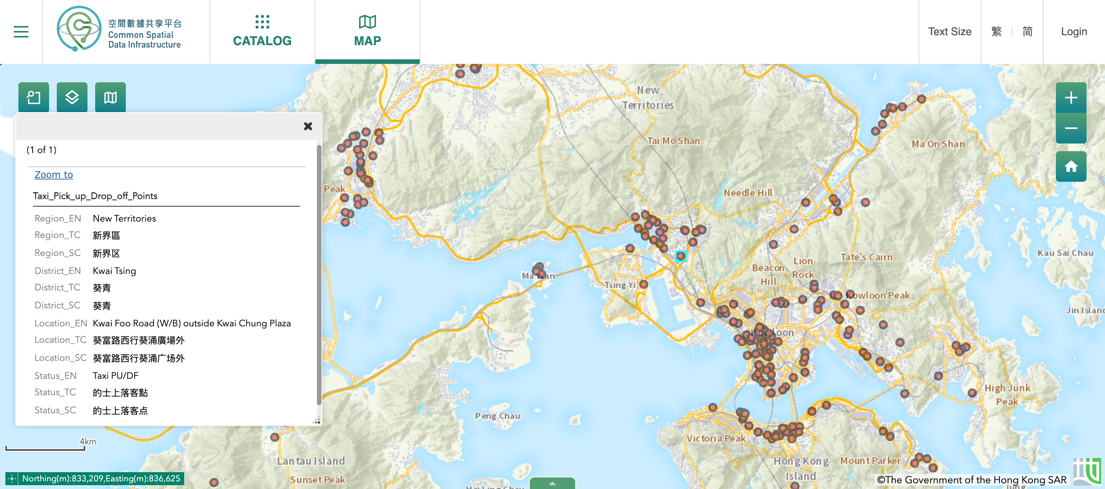
13
Future Work
PLANNED SYSTEM ENHANCEMENTS AND NEXT STEPS
DEVELOPMENT ROADMAP
Future iterations will focus on Hong Kong-specific adaptations and real-time capabilities.
Integrate real-time HK taxi pick-up/drop-off API data
Adapt to HK's multi-layer road network and altitude (Z-axis)
Enable real-time ETA updates and notifications

Slide 19

14
Challenges & Solutions
Key technical challenges were addressed through strategic adoption of open-source tools and hybrid algorithmic approaches to ensure accuracy and usability.
Haversine ignores building and transport system → OpenStreetMap + Dijkstra
Flask UI limits → Internal CSS + Tailwind CSS
Hardcore Google Maps API → Open-source OpenStreetMap
Factors → Analyze average trip time by days of week and hours of day
Data missing → Machine Learning model(Linear Regression or Random Forest)

Slide 20
Thank You!
Demostration
Q & A
Taxi Trip
Prediction
Lam Sau Cheung
Information Security
24030401D
Q&A

Slide 21
Reference
Taxi Trip
Prediction
[1]H. Leung, “Hong Kong’s taxi industry at a turning point: Can new regulations bring free-wheeling sector back on track?,” Hong Kong Free Press HKFP, Dec. 29, 2024. [image].Available: https://hongkongfp.com/2024/12/29/hong-kong-taxi-drivers-refusing-fares-dirty-cabs-rudeness-and-overcharging-will-new-rules-fix-industry/[Accessed April 7, 2026]
[2]R. Ying, "Taxi license holders shouldn't be bailed out with taxpayers' money," Chinadailyhk. Jun. 19, 2025.[Online]. Available: https://www.chinadailyhk.com/hk/article/614262.[Accessed Sept 7, 2026]
[3]Y. Liang, J. You, R. Wang, B. Qin, and S. Han, "Urban Transportation Data Research Overview: A Bibliometric Analysis Based on CiteSpace," Sustainability, vol. 16, no. 22, pp. 9615–9615, Nov. 2024.[image]. Available: https://doi.org/10.3390/su16229615.[Accessed April 7, 2026]

